Slide 1
Main Character - Sparkle -
Sparkle is everywhere, and in all things.

Slide 2
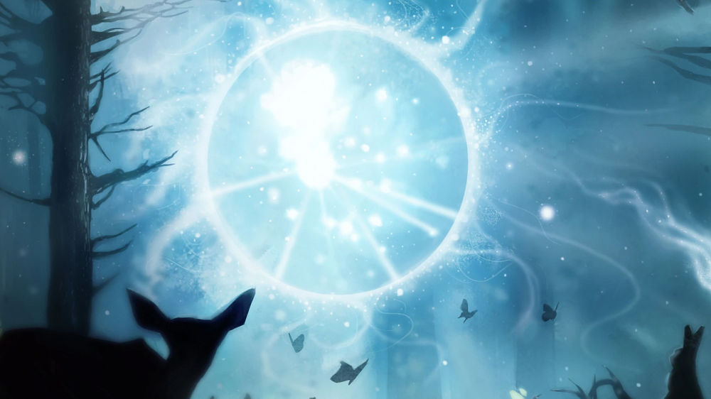
About
Like the great twin riders Dark and Light, and yet another ancient traveler whose true history is lost to the ages, Sparkle is a Fundamental of the universe, a force older than time, a wanderer from realms far beyond mortal understanding.
Sparkle is nothing less than the sum of all attractive and repulsive forces within the material field, a sentient manifestation of the charge that bind existence together
It is only in the controlled warping of these electrical waylines that Sparkle's presence can be experienced on the physical plane

Slide 3

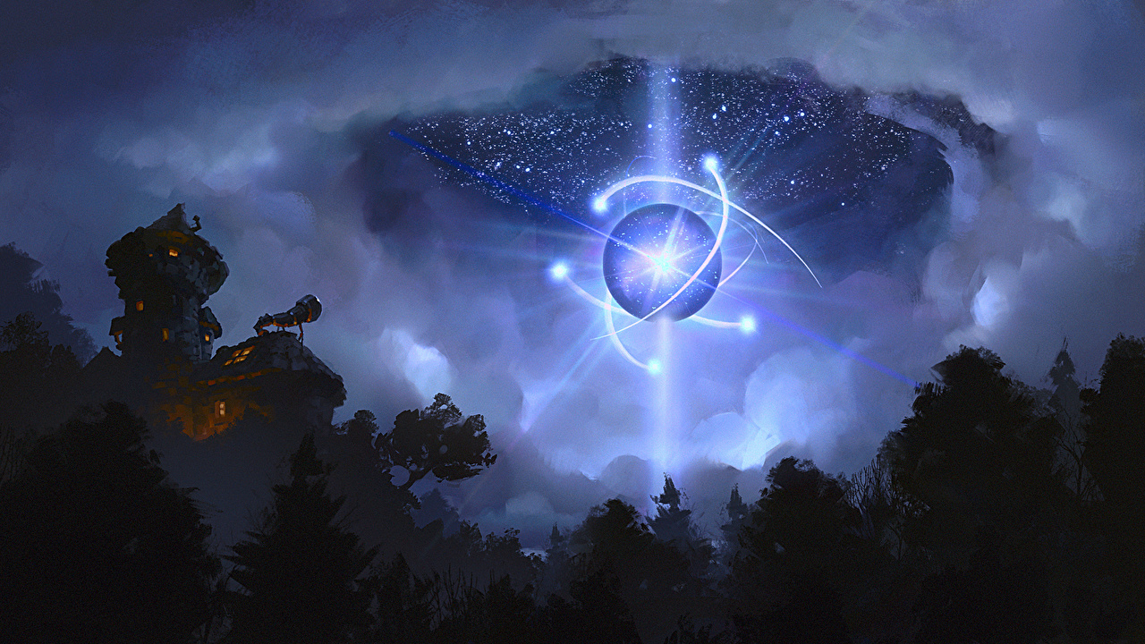
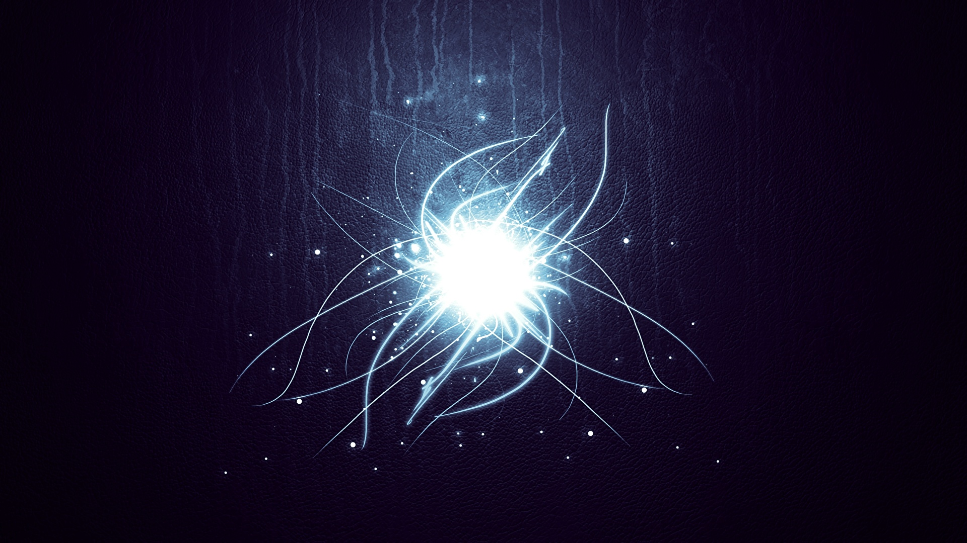
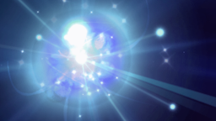
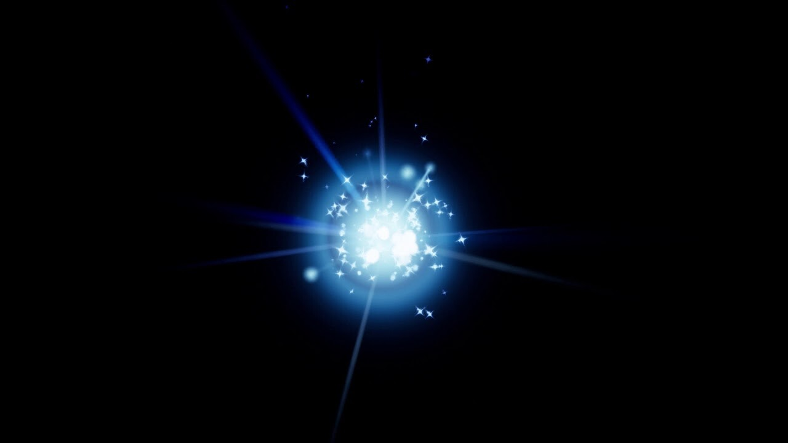
Appearance

Slide 4

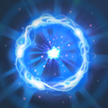
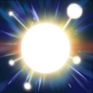

Abilities
1. Tethers Sparkle to an allied unit, granting bonus movement speed to both
2. Summon five particle spirits that dance in a circle around Sparkle
3. Sparkle gains bonus attack speed, spell amplification, and HP Regen based on max health
4. Teleports Sparkle and any tethered ally to any location

Slide 5
Overall
Sparkle is everywhere, and in all things. Denounced by enemies as the great unmaker, worshiped by scholars as the twinkling of a divine eye, this strange Sparkle of life-force occupies all planes at once, the merest fraction of its being crossing into physical existence at any one moment. Sparkle is your friend, he’s your life saver. He is everywhere with everyone. Love Sparkle be with Sparkle respect Sparkle.

